Slide 1

Making Comparisons
GRAMMAR PRESENTATION BY MR. STEFANO

Slide 2
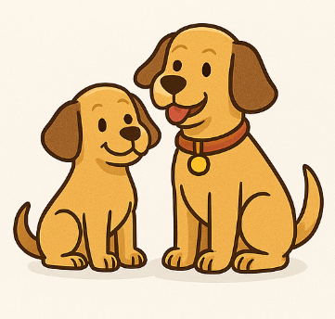
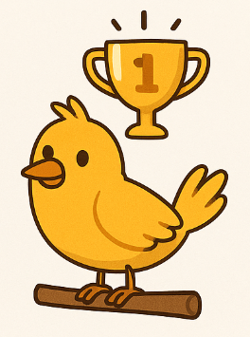
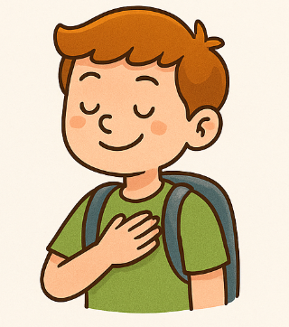
Three main types
Comparatives
Superlatives
Others

Slide 3
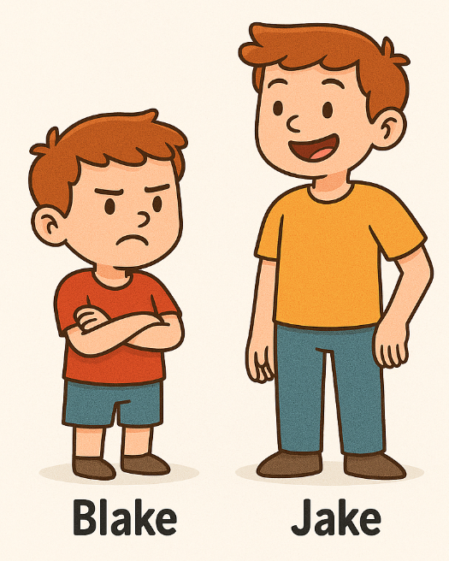
comparatives
We use the comparative form of adjectives and adverbs to compare two things or actions.
Jake is taller than Blake.
I can drive faster than you.
She looks happier than before.
It’s hotter today than yesterday.

Slide 4
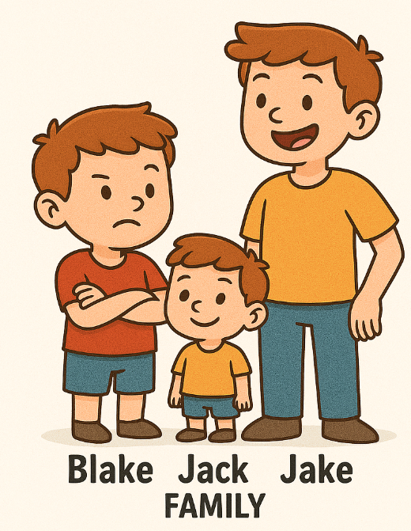
superlatives
We use the superlative form of adjectives and adverbs to compare one thing or action with a group of things or actions.
Jake is the tallest in his family.
He’s my best friend.
Yesterday was the hottest day.

Slide 5
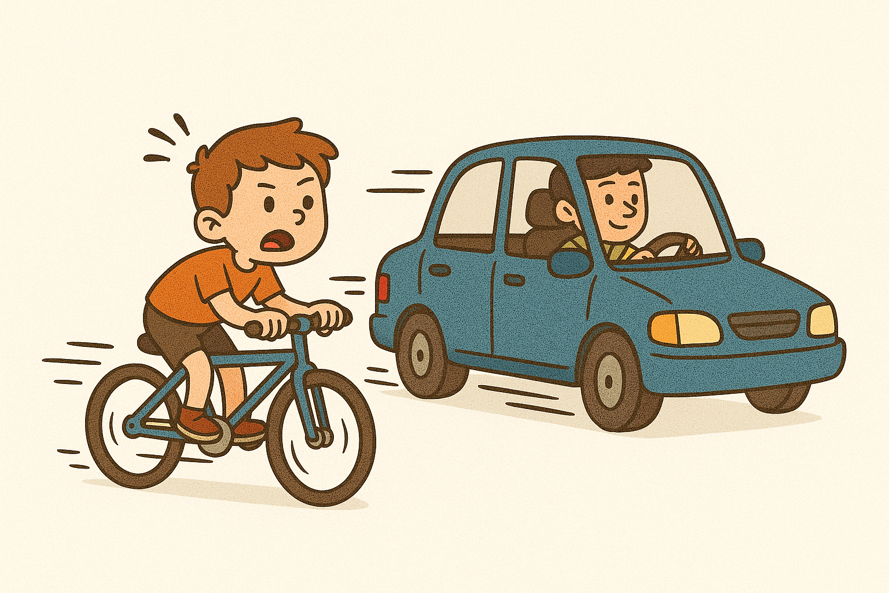
Other expressions
(not) as/so .. as
A bike is not as fast as a car.
just as … as
Mike is just as smart as Sarah.
the … the
The higher you climb, the dizzier you feel.
more … and more
Home is getting more and more difficult.

Slide 6
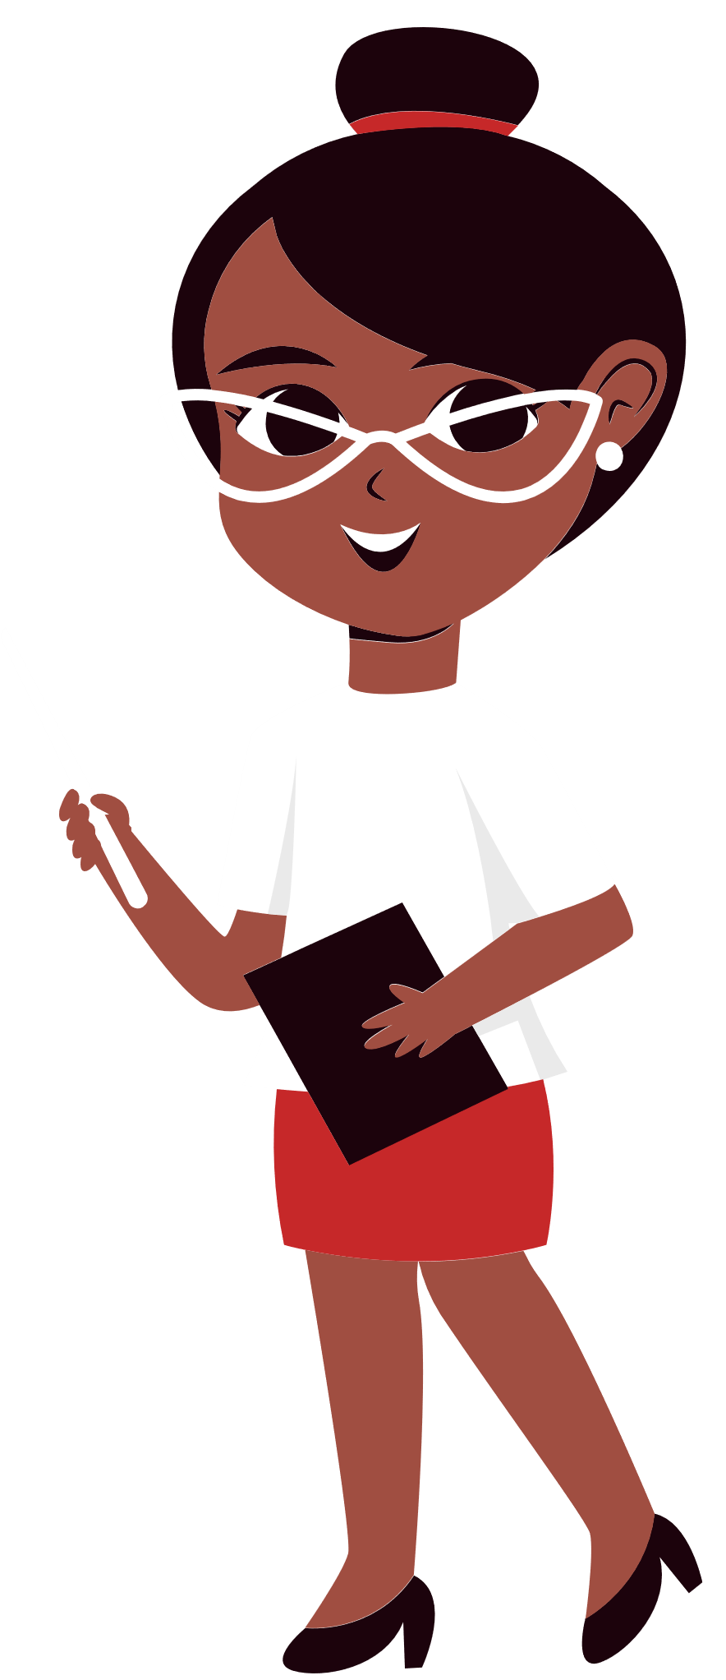
Forms
 | 1 syllable | 2 syllable | 1 syllable ending in –e | 1 syllable ending consonant-vowel-consonant | 2 or more syllables | Irregular (good/well – bad/badly – far – old**)
Comparative | -er | -ier | -r | double-consonant + -er | more.. | better worse farther/further elder
Superlative | -est | -iest | -st | double-consonant + -est | the most.. | the best the worst the farthest/ the furthest the eldest

Slide 7
Forms
Less/the least are the opposites of more/the most.
Cars are less dangerous than motorcycles.
Before comparatives, we can use much/a lot/a bit/no/any.
Your car is much faster than mine.
Superlatives are common in expressions with ever.
This is the biggest hamburger I have ever eaten.

